Slide 1
Causal Structure Learning for Sepsis Prediction in ICU Patients: EN.601.675 / Machine Learning
Prabhav Singh, Aravind Kavuturu, Sandesh Rangreji, Mukund Iyengar

Slide 2
Outline
Introduction and Motivation
Literature Review
Data Overview and Exploratory Data Analysis
Methodology and Experiments
Results
Conclusion and Significance
Notes:
Intro and Lit Rev - Mukund / Data and EDA - Sandesh / Method - Prabhav / Result & Conclusion - Aravind

Slide 3
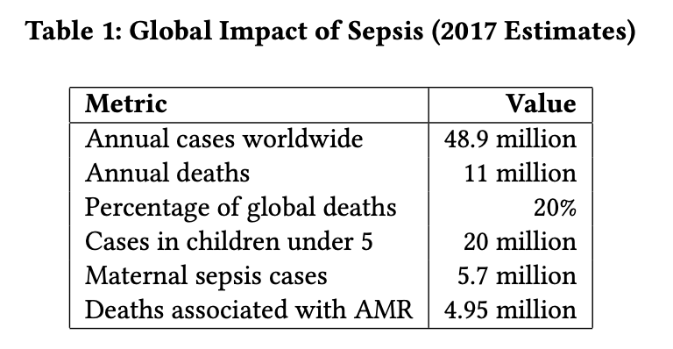
Introduction & Motivation
Sepsis is a life-threatening condition caused by an uncontrolled immune response to infection.
Often results in organ failure and high mortality rates
This condition is often detected in Intensive Care Units (ICU’s)
Sepsis affects approximately 48.9 million people annually
Causing 11 million deaths worldwide (~20% of all global deaths)

Slide 4
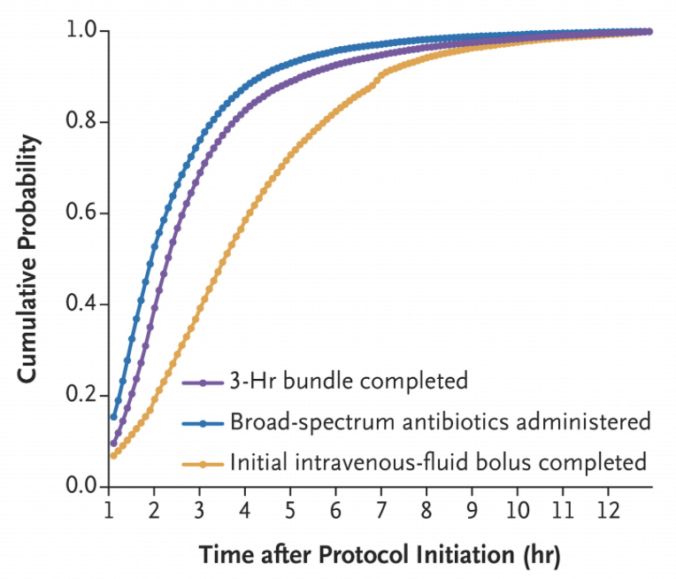
Diagnostic Challenges
No single diagnostic test exists for sepsis
Symptoms often mimic other conditions
Time Critical Nature
Early diagnosis is crucial for improved outcomes
Every additional hour associated with a significant increase in mortality probability
https://globalsepsisalliance.org/news/2017/5/23/time-to-treatment-and-mortality-during-mandated-emergency-care-for-sepsis

Slide 5
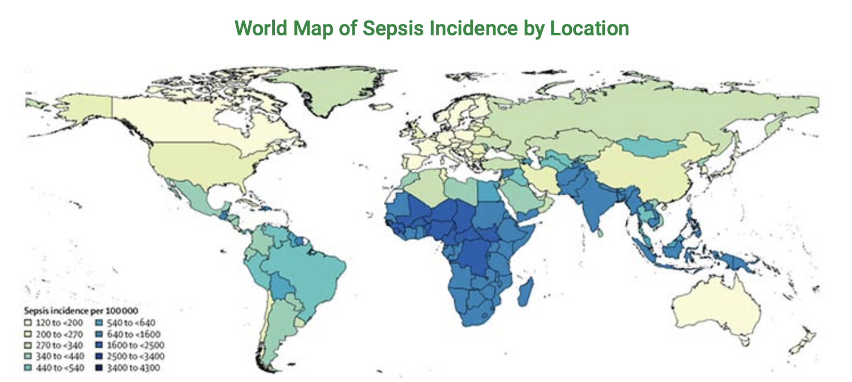
Economic Burden
Average hospitalization cost is between $20,000 - $30,000
Disproportionate impact of sepsis on vulnerable populations and countries
Estimated annual productivity loss of $5 - 10 Billion in the US
https://www.fic.nih.gov/News/GlobalHealthMatters/january-february-2020/Pages/global-sepsis-burden.aspx

Slide 6
Literature Review
Traditional ML Methods for established baseline values
Logistic Regression
Random Forest
Deep Learning Advancements
Multi-output Gaussian process combined with RNN’s - MGP-RNN
Achieved C-statistic of 0.88
Can detect Sepsis of median of 5 hours in advance
COMPOSER Algorithm: 17% relative decrease in in-hospital sepsis mortality
NLP Integration with structured EHR data
SERA Algorithm: NLP extracted features from clinical notes with structured data to predict sepsis onset up to 48 hours in advance
Achieved AUC score of 0.94

Slide 7
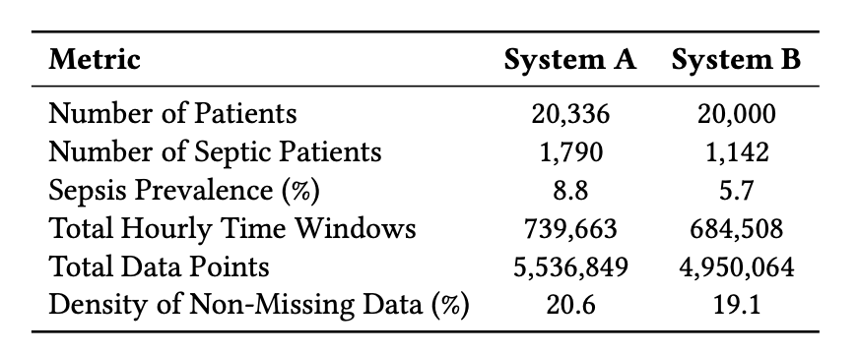
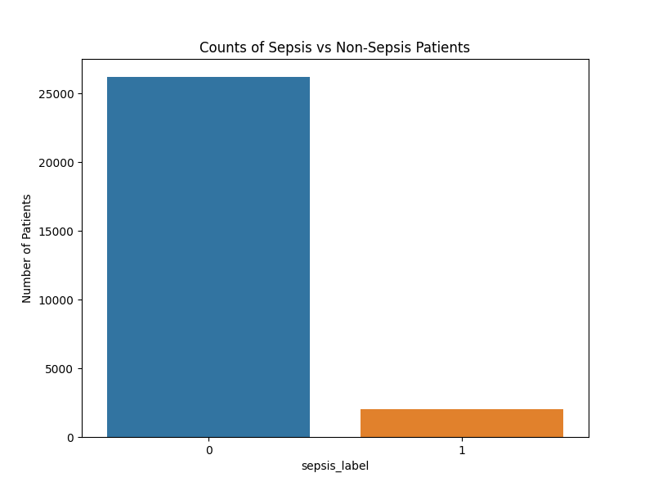
Dataset & EDA
PhysioNet Challenge 2019
De-identified electronic health records (EHR) sourced from 3 geographically distinct US hospital systems
Beth Israel Deaconess Medical System (System A)
Emory University Hospital (System B)
System C - Only used for testing
Over 60,000 patient records - 40,000 made available for training and validation

Slide 8
Dataset - Clinical Variables
Total of 40 clinical variables categorized into:
Vital Signs (8 variables):
Heart rate, oxygen saturation, temperature, blood pressure, …
Lab Values (26 variables):
Glucose, lactate, white blood cell count, …
Demographic Features (6 variables):
Age, gender, ICU length of stay, …
Sepsis labels:
Binary labels indicating sepsis onset, defined 6 hours before clinical recognition of sepsis for septic patients based on sepsis-3 criteria

Slide 9
Dataset - Data Preprocessing
Data assumed to be MCAR
Missing data is generally a result of measurements not being taken hourly for certain features (lab results, irrelevant biometrics for patient, etc.)
To deal with sparsity of certain columns:
choose the top 24 features to represent the data
Use 3 values for each feature label using statistics and last value
End up with 54 features
Data Aggregation:
All patient measurements were aggregated to mean statistics over the time series
Data Imputation:
Missing patient statistics (if a patient never received a measurement for 1 variable) were imputed from the total column mean
Such fields were extremely uncommon
Export to CSV:
Data was compiled into CSV for future caching
For train-validation-test split: use a 70-10-20 split

Slide 10
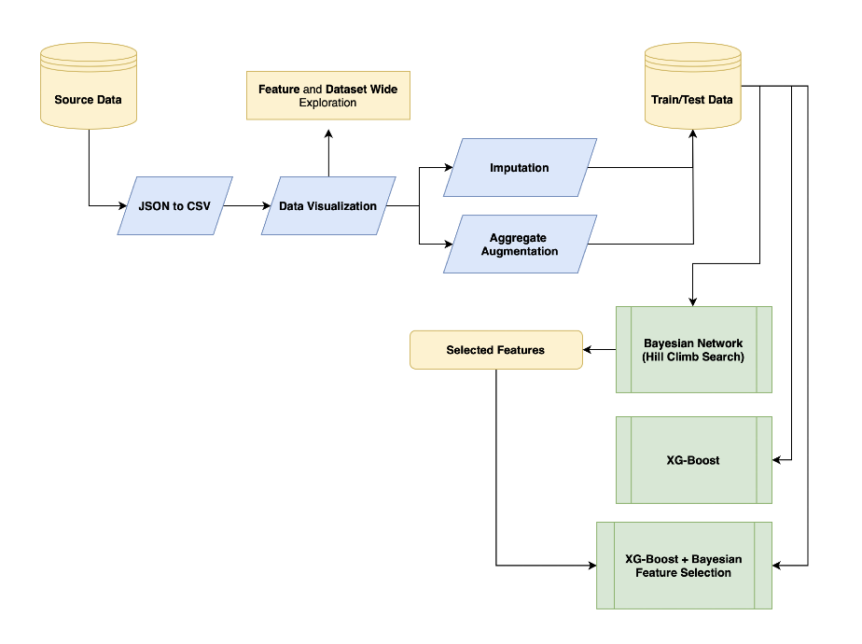
Methodology Overview

Slide 11
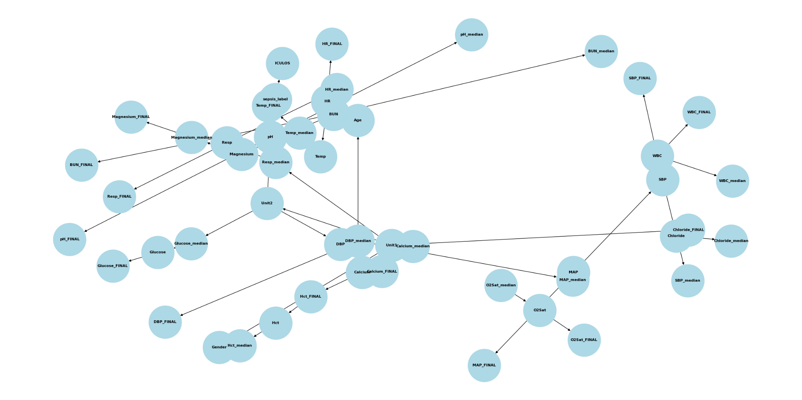
Bayesian Network for Sepsis Prediction

Slide 12
Experiments
Experiments and Hyperparameter Tuning
Datasets:
Original dataset with 54 features.
Bayesian-selected dataset with 48 features.
Experiments:
Run Bayesian Network on test and validation data as a baseline.
Train XGBoost (with and without feature selection), hyperparameter-tuned using 5-Fold CV.
XGBoost Parameters:
All Features: learning_rate = 0.2, max_depth = 3, n_estimators = 300
Bayesian Features: learning_rate = 0.2, max_depth = 3, n_estimators = 100
Key Insight:
With fewer features, XGBoost required fewer estimators, indicating efficient learning with reduced feature noise.

Slide 13
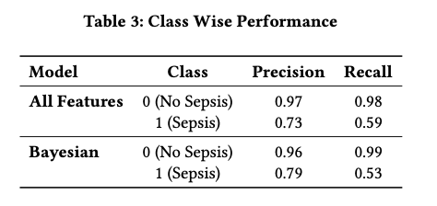
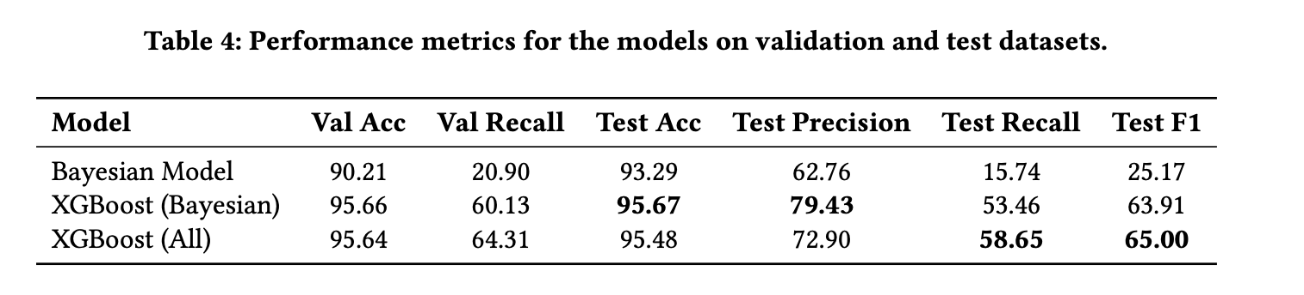
Results
Key Insights:
Trade-off between interpretability (Bayesian-selected features) and performance (all features).
Feature selection reduces noise but may miss subtle relationships captured by full feature models.
High recall is critical to minimize false negatives, given the life-threatening nature of sepsis.

Slide 14
Conclusion
XGBoost (All Features) achieved the highest F1 score (65.00%), while Bayesian-selected features balanced interpretability with F1 score (63.91%).
Sepsis remains a leading cause of preventable deaths, disproportionately impacting low-resource settings.
Our framework enables scalable and interpretable early detection in ICUs, reducing mortality rates and improving patient outcomes.
By improving such models and integrating into clinical workflows, healthcare systems can provide timely and life-saving interventions.

Slide 15
Questions?

